Slide 1


Week 1
Object Oriented
Software Engineering
John Andrews

Slide 2
Housekeeping
Attendance. Please aim to attend all sessions (correlation and causation between class attendance and module success).
Participation. Do discuss and participate: your contributions are central to the learning process
Moodle instance. Only one Moodle instance will be maintained. Please ensure you are registered in the correct instance.
Plagiarism. Strict on NCI plagiarism policies. Ensure you are 100% familiar with rules. Check library for policy document.
Breaks. Typically we will take a break in the middle of a 2 hour session.
Slides. Slides will be posted after lectures (on Moodle).
Technical difficulties. Systems may be down, Internet outages – they will happen but hopefully not too frequently!
Enjoy the process!

Slide 3

Software Engineering:
Motivation

Slide 4
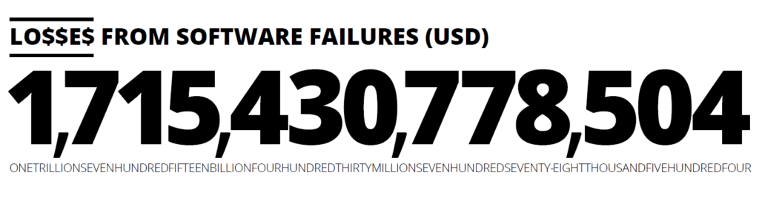
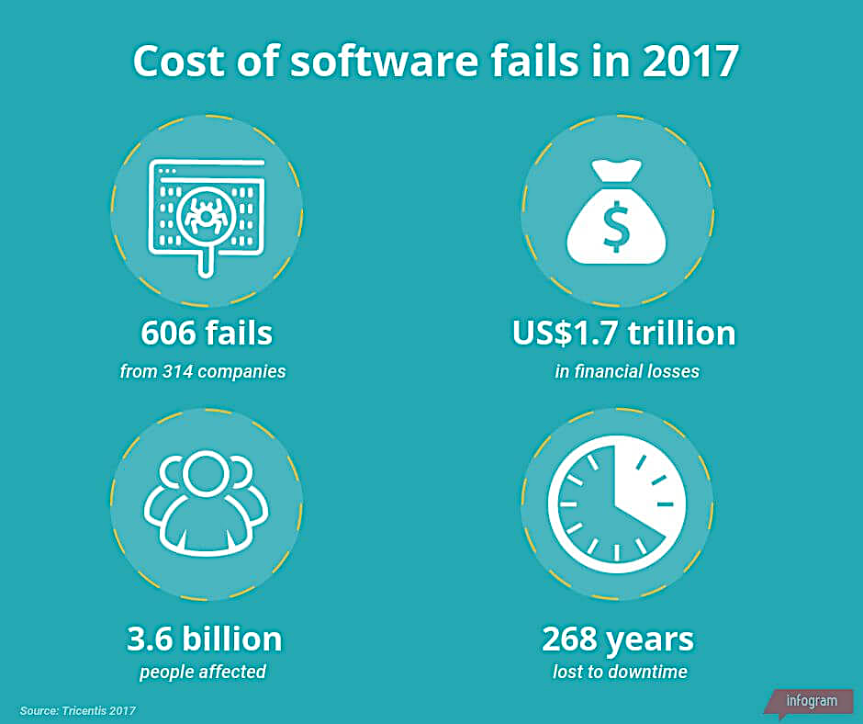
Source: Tricentis https://www.tricentis.com/resources/software-fail-watch-5th-edition/

Slide 5
1.2 Definition: What is Software Engineering?...
The process of solving customers’ problems by the systematic development and evolution of large, high-quality software systems within cost, time and other constraints
Other definitions:
IEEE: (1) the application of a systematic, disciplined, quantifiable approach to the development, operation, maintenance of software; that is, the application of engineering to software. (2) The study of approaches as in (1).
The Canadian Standards Association: The systematic activities involved in the design, implementation and testing of software to optimize its production and support.

Slide 6
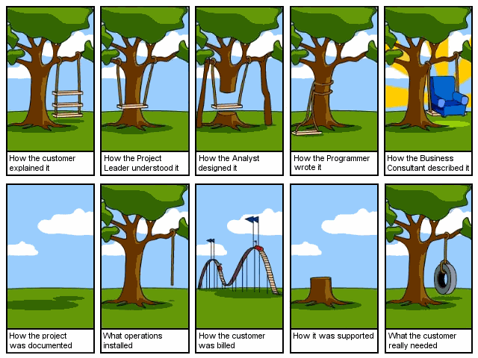
Software Engineering

Slide 7

Software BUGs – SPACE disaster
Maiden flight of the Ariane 5 rocket on the 4th of June 1996
The reason for the explosion was a software error (Attempt to cram a 64-floating point number to a 16-bit integer failed)
Financial loss: $500,000,000 (including indirect costs: $2,000,000,000)

Slide 8
Phases in the Design Process

Slide 9
The Design Process
The system should be described at several different levels of abstraction.
Design takes place in overlapping stages. It is artificial to separate it into distinct phases, but some separation is usually necessary.

Slide 10
Software Design in Reality
Design mixed with implementation
Design step 1
Implement and add more design
Design step 2
Implement and add more design
In effect much of software is designed while being coded and the design document doesn’t reflect the final product

Slide 11
Software Design
Why
Software is produced by many people
Software needs to be
Simple
Understandable
Flexible
Portable
Re-usable
How
Complex to simple
Abstraction

Slide 12
Stages of Design
Problem understanding
Look at the problem from different angles to discover the design requirements.
Identify one or more solutions
Evaluate possible solutions and choose the most appropriate depending on the designer's experience and available resources.
Describe solution abstractions
Use graphical, formal or other descriptive notations to describe the components of the design.
Repeat process for each identified abstraction
Look iteratively at each level of abstraction.

Slide 13
Software Engineering Myths: Customer
“We can refine the requirements later”
A recipe for disaster.
“The good thing about software is that we can change it later easily”
As time passes, cost of changes grows rapidly

Slide 14
Software Engineering Myths: Practitioner
“Let’s write the code, so we’ll be done faster”
“The sooner you begin writing code, the longer it’ll take to finish”
60-80% of effort is expended after first delivery
“Until I finish it, I cannot assess its quality”
Software and design reviews are more effective than testing (find 5 times more bugs)
“There is no time for software engineering”
But is there time to redo the software?

Slide 15
Teams and Specifications
Do we really need to write specifications?
A typical software team will in general do the following:
Discuss what to do
Divide up the work
Implement incompatible components
Be surprised when it doesn’t all just work together

Slide 16
Specification
A specification allows us to:
Check whether software works – gives something to test against
Build software in teams at all
Actually checking that software works is hard
Code reviews
Static analysis tools
Testing and more testing

Slide 17
How Do We Code Efficiently?
Assume we want to minimize time
Usually the case
Time-to-market exerts great pressure in software
How can we code faster?
Obvious answer: Hire more programmers!

Slide 18
Parallel Development
How many programmers can we keep busy?
As many as there are independent tasks
People can work on different modules
Thus we get parallelism
And save time
What are the pitfalls?

Slide 19
Pitfalls of Parallel Development
The problems are the same as in parallel computing
More people = more communication
Which is hard
Individual tasks must not be too fine-grain
Increases communication overhead further

Slide 20
Interfaces
The chunks of work must be independent
But work together in the final system
We need interfaces between the components
To isolate them from one another
To ensure that the final system works
The interfaces must not change (much)!

Slide 21
Defining Interfaces
Interfaces are just specifications!
But of a special kind
Interfaces are the boundaries between components
And people
Specifying interfaces is most important
Interfaces should not change a lot
Effort must be spent ensuring everyone understands the interfaces
Both things require preplanning and time
But often we can stop at specifying interfaces
Let individual programmers handle the internals themselves

Slide 22
Efficient software development
Efficient development requires
Decomposing system into pieces
Good interfaces between pieces
The pieces should be large
Don’t try to break up into too many pieces
Interfaces are specifications of boundaries
Must be well thought-out and well communicated

Slide 23
How to obtain Software Reliability?
Testing, testing, testing, …
Many software errors are detected this way
Does not provide any correctness guarantee
“Murphy’s Law”
Verification
Provides a formal mathematical proof that a program is correct w.r.t. a certain property
A formally verified program will work correctly for every given input
Verification is algorithmically very hard task (problem is in general undecidable)

Slide 24

Software Engineering Intent
The intent of software engineering is to support professional software development, not individual programming
Four fundamental activities common to all software
Specification – define what is needed
Development – program what is needed
Validation – ensure the program is what is needed
Evolution – modify the program based on new requirements

Slide 25
Conclusions
Software engineering boils down to several issues:
Specification: Know what you want to do
Design: Develop an efficient plan for doing it
Programming: Do it
Validation: Check that you have got what you wanted
Specifications are important
To even define what you want to do
To ensure everyone understands the plan

Slide 26
Semester outputs/ grading

Slide 27
Semester output
Project Part 1 (50%)
Project Part 2 (50%)

Slide 28
Object Orientation

Slide 29
What is an Object?
An object is a software bundle of related state and behavior. Software objects are often used to model the real-world objects that you find in everyday life. This lesson explains how state and behavior are represented within an object, introduces the concept of data encapsulation, and explains the benefits of designing your software in this manner.

Slide 30
Object Oriented paradigm
An approach to the solution of problems in which all computations are performed in the context of objects.
Objects are instances of classes, which:
are data abstractions
contain procedural abstractions that operate on the objects
A running program can be seen as a collection of objects collaborating to perform a given task

Slide 31
Classes
A class:
A unit of abstraction in an object oriented (OO) program
Represents similar objects
Its instances
A kind of software module
Describes its instances’ structure (properties)
Contains methods to implement their behaviour

Slide 32
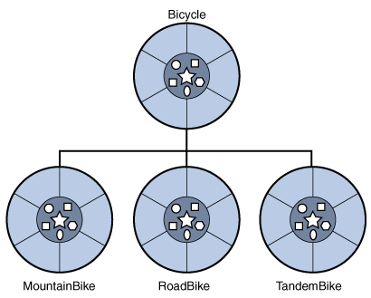
A hierarchy of bicycle classes
class MountainBike extends Bicycle
{
// new fields and methods defining a mountain bike would go here
}

Slide 33

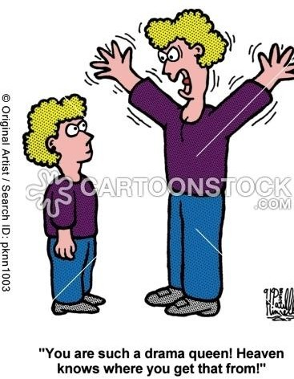
Inheritance means that methods and/or attributes defined in an object class can be inherited or reused by another object class.
Super class
Parent class
Base class
Subclass
Child class
Extended class

Slide 34
An Inheritance Hierarchy
Vehicle
Automobile
Motorcycle
Bus
Sedan
Sports Car
Luxury Bus
School Bus
What properties does each vehicle inherit from the types of vehicles above it in the diagram?

Slide 35
Object-Oriented Design
The system is viewed as a collection of interacting objects.
The system state is decentralised and each object manages its own state.
Note use of internal state against functional programming
Objects may be instances of an object class and communicate by exchanging messages.

Slide 36
Is Something a Class or an Instance?
Something should be a class if it could have instances
Something should be an instance if it is clearly a single member of the set defined by a class
Film
Class; instances are individual films.
Reel of Film:
Class; instances are physical reels
Film reel with serial number SW19876
Instance of ReelOfFilm
Science Fiction
Instance of the class Genre.
Science Fiction Film
Class; instances include ‘Star Wars’
Showing of ‘Star Wars’ in the Phoenix Cinema at 7 p.m.:
Instance of ShowingOfFilm

Slide 37
Naming classes
Use capital letters
E.g. BankAccount not bankAccount
Use singular nouns
Use the right level of generality
E.g. Municipality, not City
Make sure the name has only one meaning
E.g. ‘bus’ has several meanings

Slide 38
2.5 Organizing Classes into Inheritance Hierarchies
Superclasses
Contain features common to a set of subclasses
Inheritance hierarchies
Show the relationships among superclasses and subclasses
A triangle shows a generalization (in UML)
Inheritance
The implicit possession by all subclasses of features defined in its superclasses

Slide 39
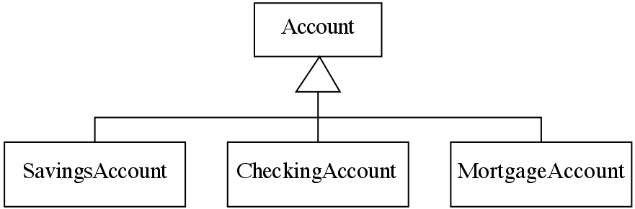
An Example Inheritance Hierarchy
See in Umple
Inheritance
The implicit possession by all subclasses of features defined in its superclasses

Slide 40
Unified Modelling Language (UML)

Slide 41
Unified Modeling Language (UML)
The Unified Modeling Language (UML) is a standard language for specifying, visualizing, constructing, and documenting the artifacts of software systems, as well as for business modeling and other non-software systems.
UML represents a collection of engineering best practices that have proven successful in the modeling of large and complex systems.
UML is a very important part of developing object-oriented software and the software development process.
UML uses mostly graphical notations to express the design of software projects.
Using UML helps project teams communicate, explore potential designs, and validate the architectural design of the software.

Slide 42
UML Tools

Slide 43
Directed Learning
Labs
Use Cases
Udemy Video

